Slide 1
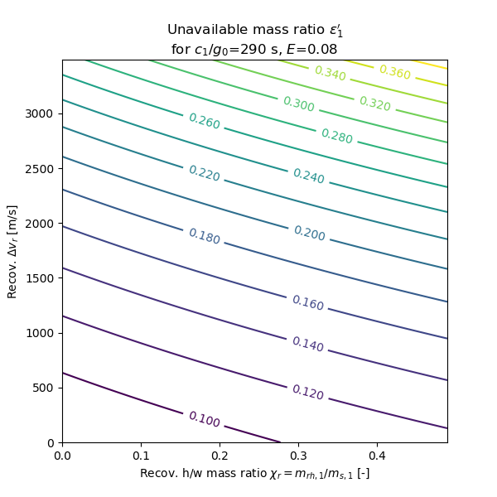
Rocketback+prop entry+prop land
prop entry+prop land
Launch site
Aero entry+prop land
Wing (glider)
Wing (air-breathing)
Downrange

Slide 2
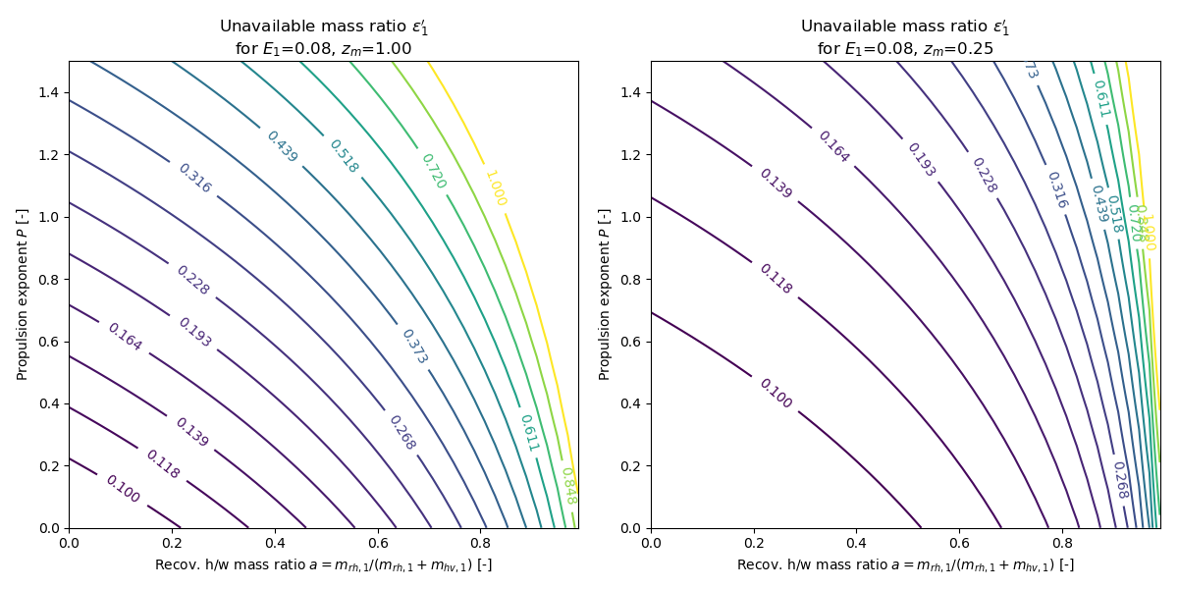
Rocketback+prop entry+prop land
prop entry+prop land
Aero entry+prop land
Wing (air-breathing)
Wing (air-breathing)
NASA LFBB
Wing (glider)
Aero entry+prop land
Wing (glider)

